Slide 1
EE400D Saws team results presentation
Garrett Bondoc
code overview
Sweepsun(); algorithm

Slide 2
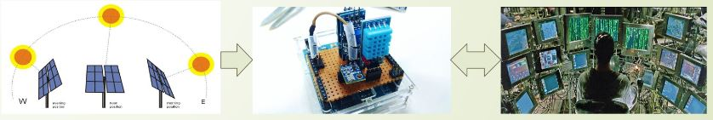
SAWS project overview
Solar Powered Weather Station
Solar Panel Tracks the sun for efficiency
Power is supplied to the hub and the sensors
Hub is responsible for motor control, power distribution, and data analysis.
Collected weather data is recorded for observation from a user’s point of view.
Today we will discuss the Solar Tracking Algorithm.

Slide 3
Solar tracking algorithm (sta) requirements
Solar Array should be controllable in degrees or steps
Solar Array will rotate azimuth 360 degrees
Solar Array will rotate altitude 90 degrees
Solar Array will power up/down based on Real Time Clock, failed sweeps, or manual user input.
Solar Array will sweep entire scope to find sun and calibrate azimuth and altitude positioning.
Solar Array should be autonomous

Slide 4
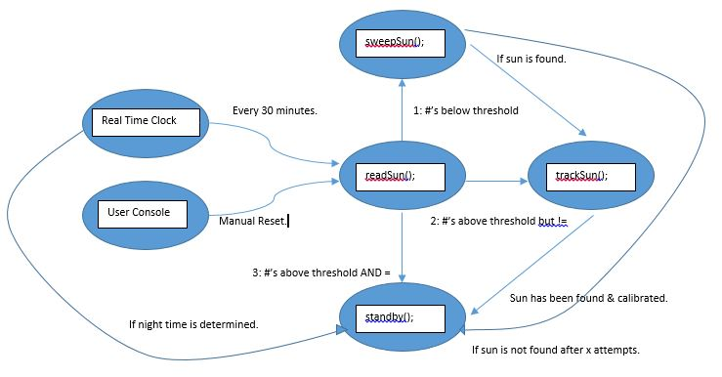
STA state diagram

Slide 5
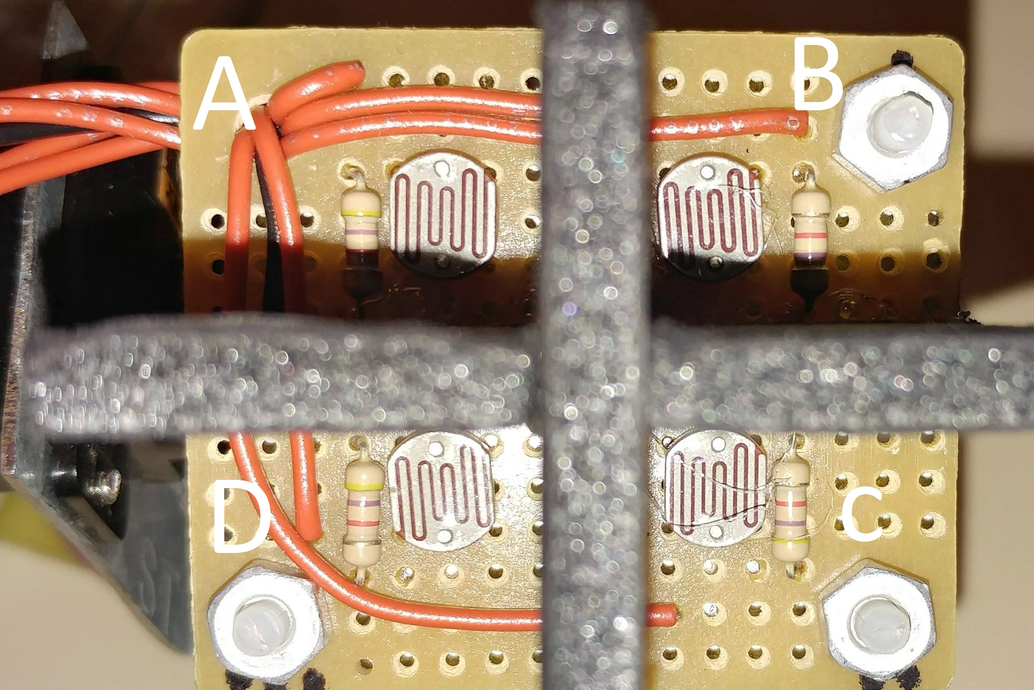
Readsun(); objectives
Main program will begin with readSun(); and begin every 30 minutes or when morning takes place (Real Time Clock)
Take an analog reading of the 4 photresistors.
Select an algorithm option based on the intensity and calibration of the sun.
3 options: sweep, track, or stand by.

Slide 6
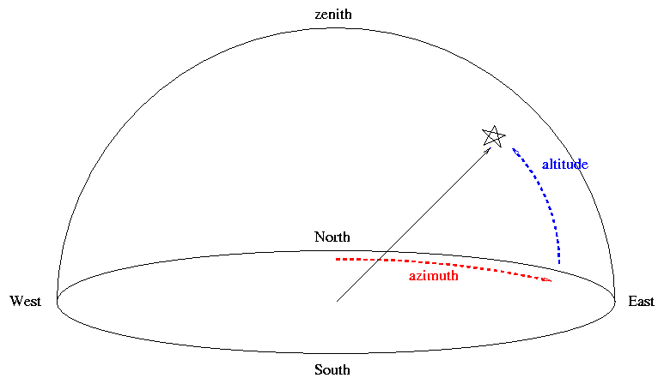
Sweepsun(); objectives
Select this option if the values are unequal and below threshold.
On azimuth, rotate the panel the full range to find the sun.
Rectifies situations of physical disturbance, poor placement and, shade.
Transitions to trackSun(); if sun is found.
Transitions to standby(); if sun isn’t found after x attempts.

Slide 7
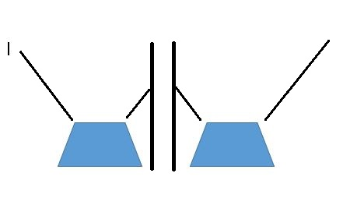
Tracksun(); objectives
Select this option if values are above threshold but are unequal or if sweepSun(); was successful.
AD average = BC average = azimuth
AB average = CD average = altitude
The cross wall focuses sun angle for comparison.
Transition to standBy(); once calibrated.

Slide 8
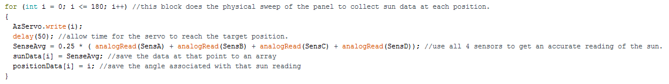
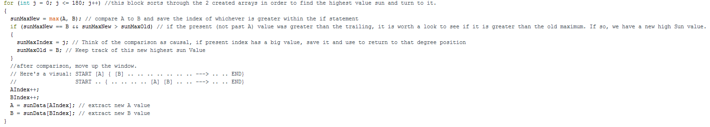
Sweepsun(); details
For loop #1 associates every degree with a sunData reading, an averaged value from ABCD.
Loop #2 uses a sort algorithm to find the index of the highest sun then turn the panel back to that position.

Slide 9
Sweepsun(); demonstration

Slide 10
EE400D Saws team results presentation
James Donahue
Solar Tracking prototype
Tracksun(); algorithm

Slide 11
Tracksun(); details
Track sun is a modular function that is meant to be easily integrated into our main program
Track sun is used to point the solar array at the sun, when the sensors can distinguish a brighter part of the sky
Track sun uses 2 PID controllers to first correct light deviations on the Azimuthal axis then the elevation axis
The code prototype output will be modified to work with a stepper motor

Slide 12
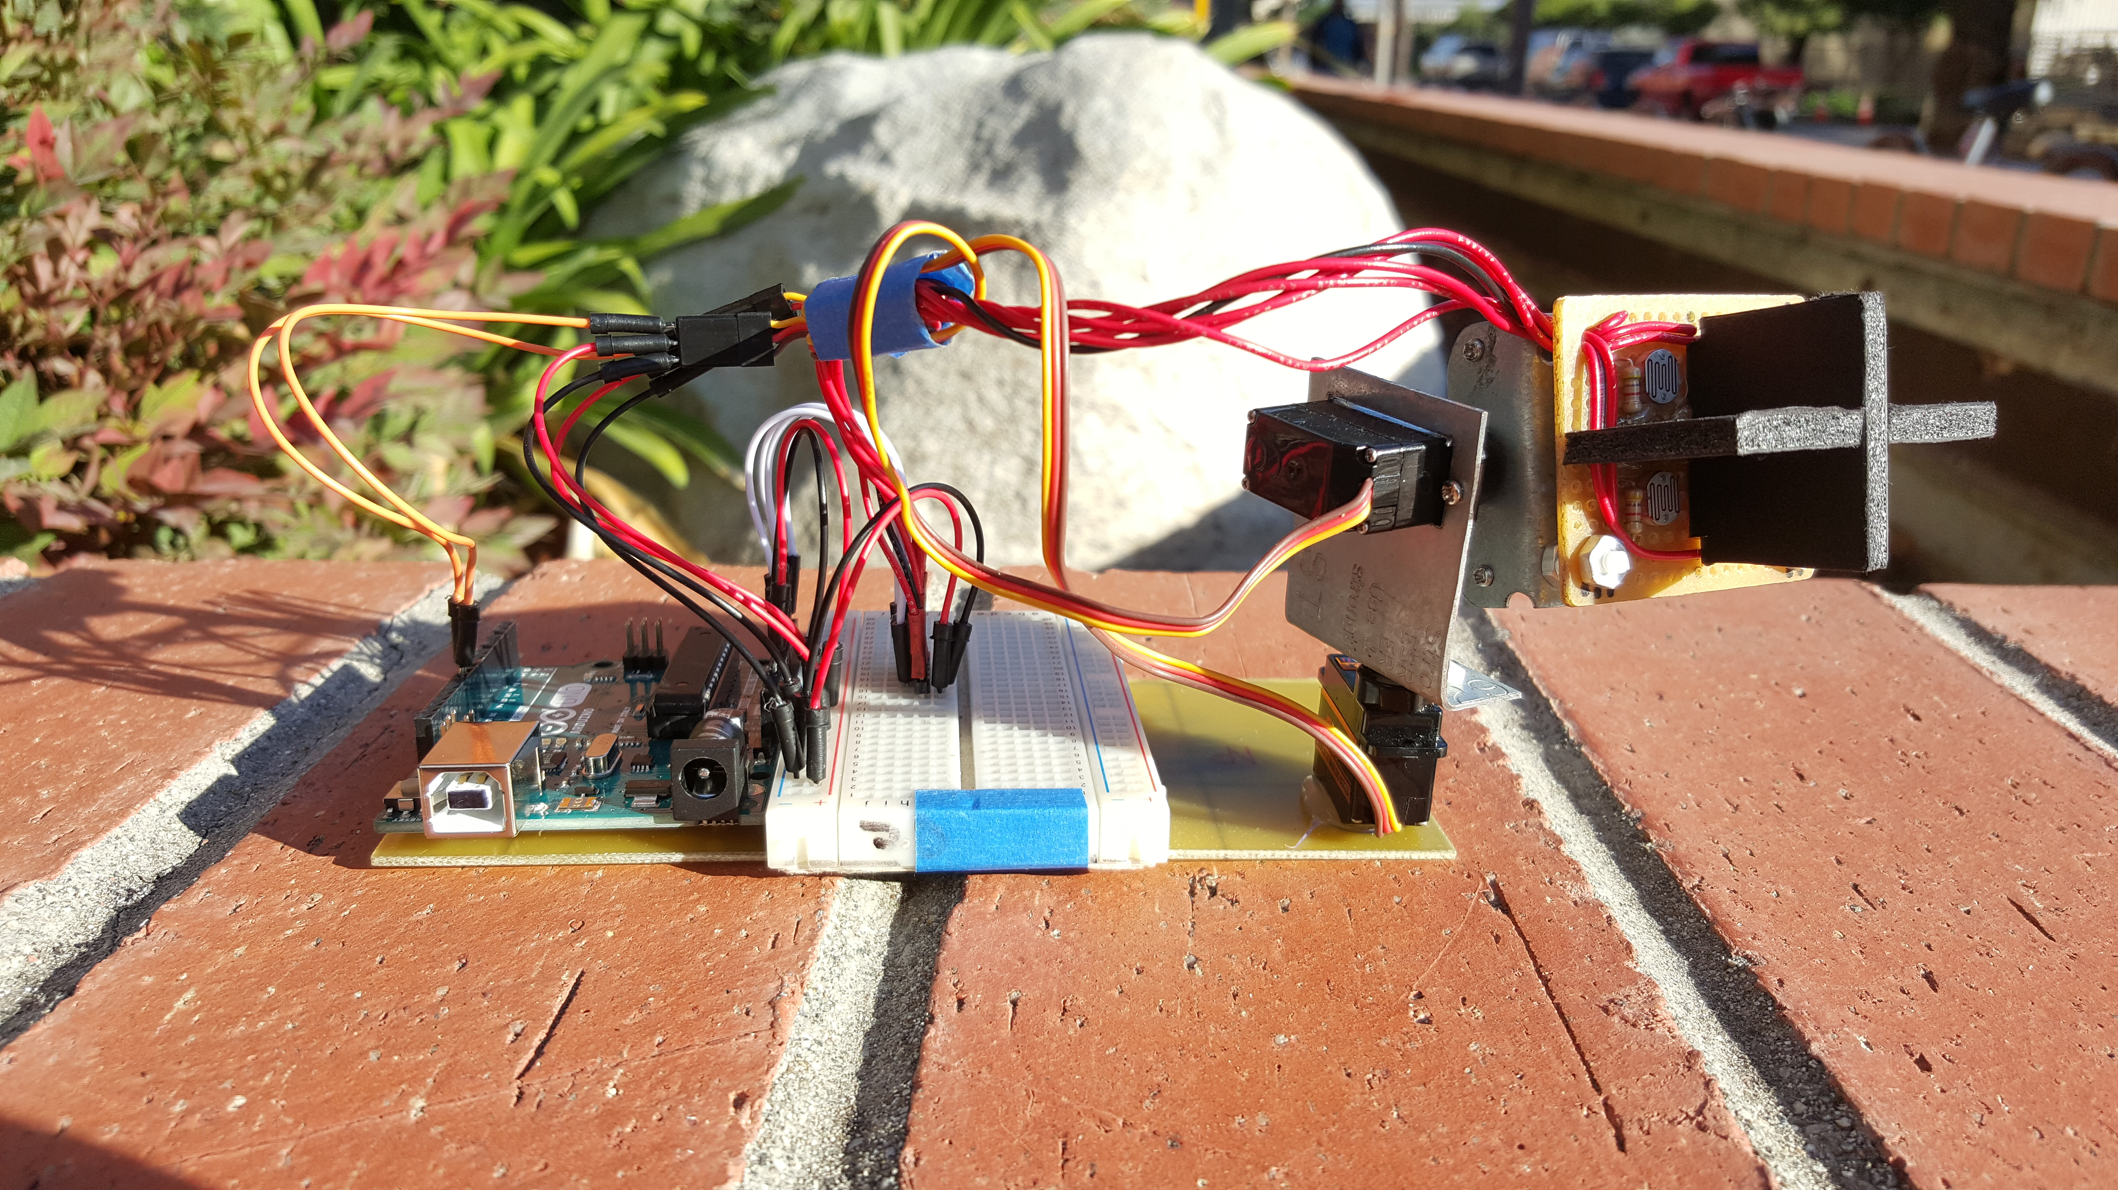
Solar tracking prototype – Objectives
Simple hardware demonstrator, to help with project design
Test sun locating techniques, using a quad sensor arrangement
Test the performance of photo-resistor voltage dividers
Hardware platform to test our PID controller

Slide 13
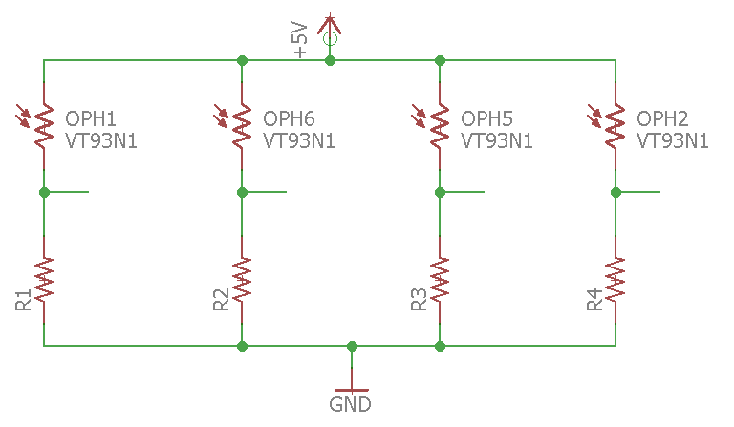
Photoresistor Voltage Divider
The resistance of an LDR decreases as light intensity increases
The sensor outputs a voltage that is proportional to the sunlight
The Arduino Microcontroller polls the value using analogRead();

Slide 14
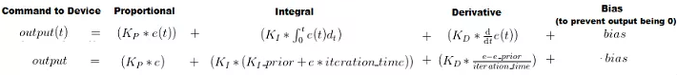
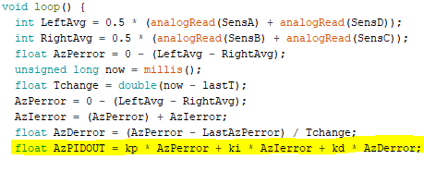
Simple PID Controller in Arduino

Slide 15
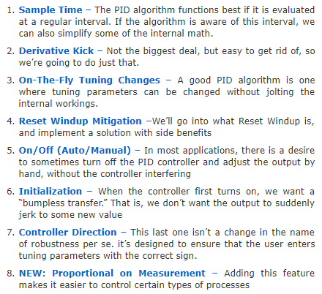
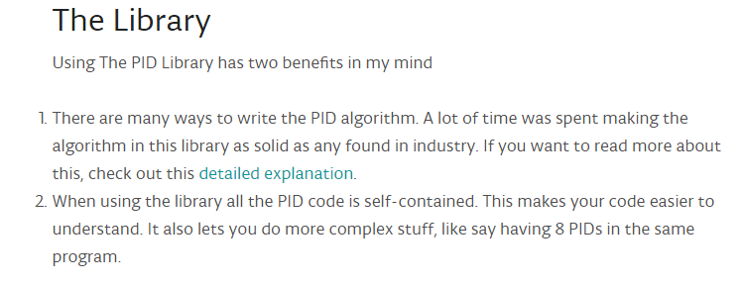
Performance Changes TO Tracksun();

Slide 16
Tracksun(); demonstration

Slide 17
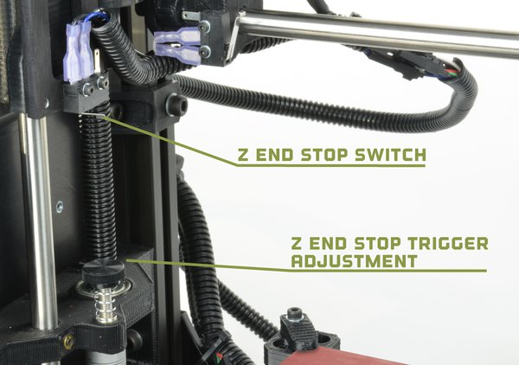
Servos to stepper adaptation
The final prototype will use stepper motors to turn the gantry's axis
The PID controller outputs an angle from 0° to 180° for use with servo motors
Standard steppers don’t provide absolute position feedback
We will use end switches to ‘home’ the gantry similar to CNC machine homing

Slide 18
Questions?

